Slide 1

Indian Institute of Information Technology, Pune
BTP Presentation
On
Movie Recommendation System

Slide 2
Mentor :
Dr. Bhupendra Sharma
Team Members :
Abhishek Jugdar - 111715003
Aditya Raut - 111715004
Anand Pawar - 111715009

Slide 3
Outline
Recommendation Systems have become very popular nowadays
with the increasing use of Internet.
Though there have been multiple implementations of movie
recommendation systems yet they are far from optimal.
We are using a small dataset of 5000 movies from IMDB and
based on its various features we will recommend related movies
to the user.

Slide 4
Introduction
A recommendation system is a type of information filtering system which attempts to predict the preferences of a user, and make suggestions based on these preferences.
There are a wide variety of applications for recommendation systems. The content of online platforms which use recommendation systems varies from movies, music, books, videos, e-commerce products as well as search results on Google.
But mainly during this project we focussed on movie recommendation system.

Slide 5
Motivation
Our motivation behind developing a movie recommendation system is the scale of its impact.
For example, if Amazon observes that a large number of customers who buy the latest Apple Macbook also buy a USB-C-to- USB Adapter, they can recommend the Adapter to a new user who has just added a Macbook to his cart.
So, we are trying to make a recommender which can recommend movies based on the features such genres, director, lead cast and plot keywords.

Slide 6
Literature Review

Slide 7
Research Gaps

Slide 8
Problem Statement
The problem statement that we will be working on is :
“Creating a list of recommended movies based on the movie selected by the user.”

Slide 9
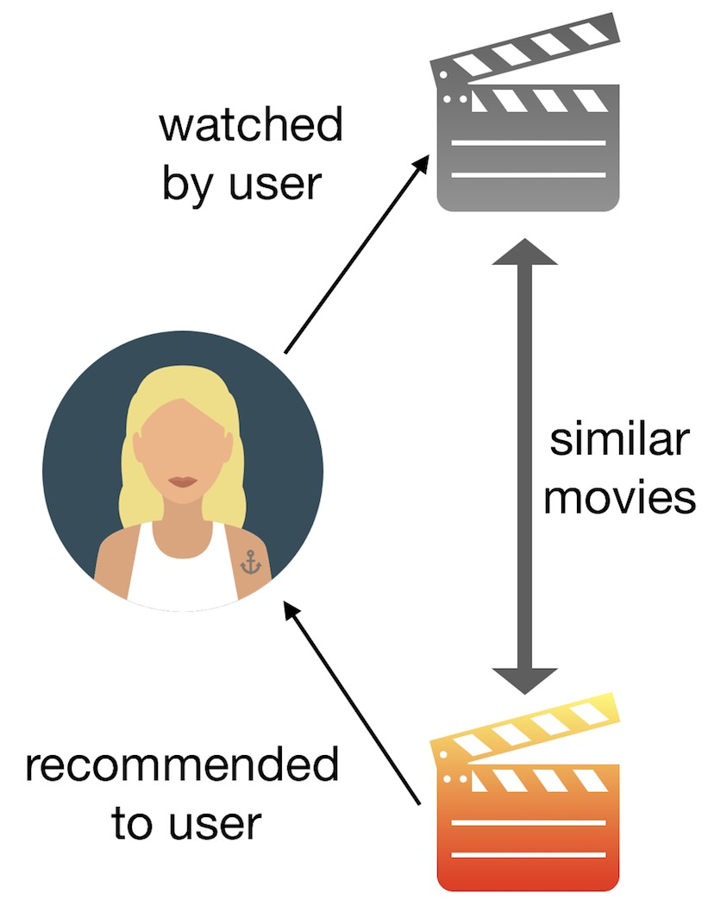
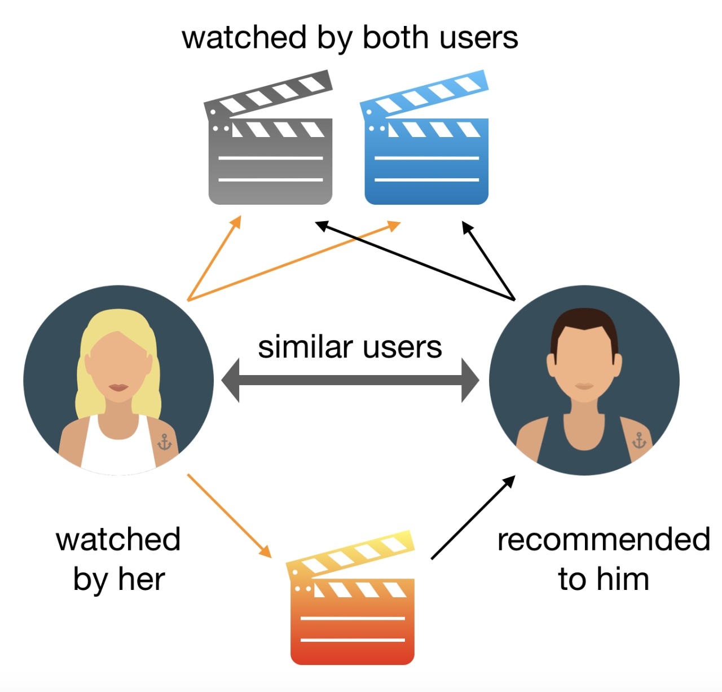
Methodology
There are majorly 2 types of recommendation system –
Content based filtering
Collaborative filtering

Slide 10
Here we are using the content based filtering approach such that we trying to find movies which are relevant to the current user input based on features in the dataset which are more likely to have some impact upon the similarities among the movies. Some of these features are Genres, Movie plot keywords, Director, Cast info, Rating.
To implement this model we will be using tools such as Scikit learn and Pandas for extracting and pre-processing the dataset.
We are using the Cosine similarity function which is calculated by comparing the multidimensional parameters computed via the dominant features of the movie.

Slide 11
Gantt Chart
Kick Off
Tue 3/9
Literature Review Completed
Wed 18/9
Preparatory Phase
Sun 8/9
Data Cleaning
Implementation
Performance Optimization
Documentation
Sat 28/9
Thu 10/10
Wed 30/10
Wed 20/11
2019
Sep
Oct
Nov
2019
Today
Tue 24/9
Data Collection
Tue 15/10
PreProcessing
Mon 25/11
Sign Off

Slide 12
Expected Outcome
The outcome will be list of movies which will be “relevant” to the given movie on basis of the weighted features as specified by the user such that the more “relevant” movie will be ranked higher.

Slide 13
References
Recommendation Systems - https://www.microsoft.com/en-us/research/lab/microsoft-research-asia/articles/personalized-recommendation-systems/
Cosine Similarity - https://en.wikipedia.org/wiki/Cosine_similarity
Dataset containing features and stats about 5000 different movies –
https://www.kaggle.com/deepmatrix/imdb-5000-movie-dataset
Related Scikit Learn documentation - https://scikit-learn.org/stable/modules/preprocessing.html#preprocessing
Related Pandas documentation - https://pandas.pydata.org/pandas-docs/stable/reference/api/pandas.DataFrame.html

